Slide 1

MavenFlix Video Streaming Subscription Analysis
Key Subscription Insights & Trends
by
Edward Opare-Yeboah
Data Analyst
May 16, 2025

Slide 2

Introduction
To support better business decisions, this project analyzes MavenFlix’s subscription data to uncover meaningful insights into how subscriptions have grown over time, how loyal customers are, and when retention has been strongest or weakest.
The analysis focuses on three key business questions:
1️⃣ Subscription Trends: How subscriptions have trended month by month.
2️⃣ Customer Loyalty: What share of customers stay subscribed for five months or longer.
3️⃣ Retention Performance: Which months show the highest and lowest subscriber retention rates.

Slide 3

Objective
The goal is to provide actionable insights that help MavenFlix strengthen subscriber growth, reduce churn, and support data-driven marketing and retention strategies.

Slide 4


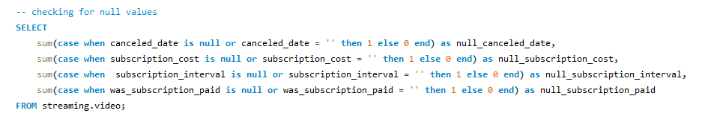
Data Cleaning & Preparation
Checked for null values in:
canceled_date
subscription_cost
subscription_interval
was_subscription_paid

Slide 5
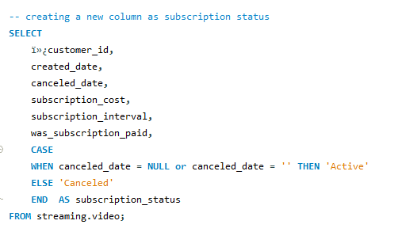
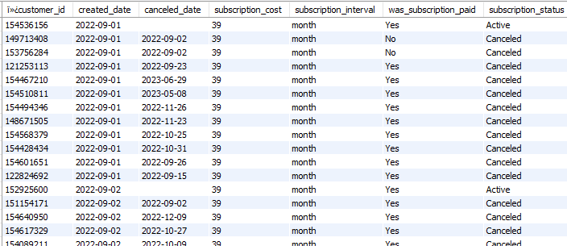
Data Cleaning &Preparation Cont’d
Created a new column subscription_status: This is to know which customers are active or canceled.

Slide 6





Key Performance Indicators
Total Users
Active Users
Canceled Users
3069
1065
2004
Month with highest subscription
Month with highest canceled subscription
July 2023
June 2023

Slide 7
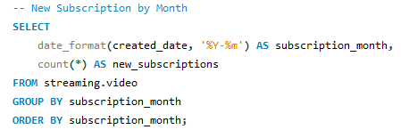
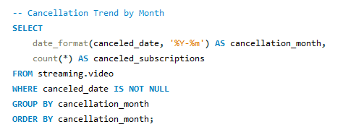
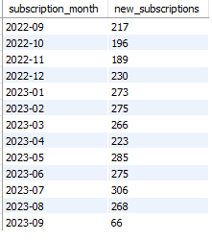
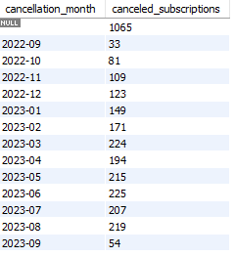
Subscription Trend over Time
How have MavenFlix subscriptions trended over time?

Slide 8
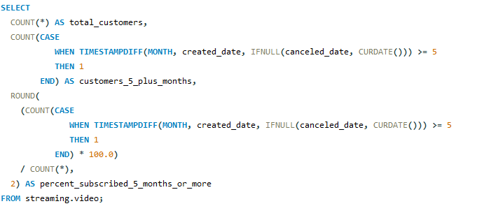
Long Term Subscriber Loyalty
What percentage of customers have subscribed for 5 months or more?

Slide 9
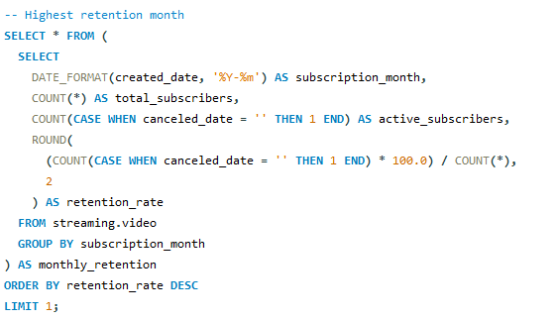
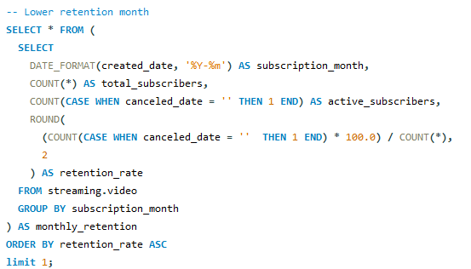

Retention by Month
What month had the highest subscriber retention, and the lowest?

Slide 10
Key Findings
Steady subscriber growth observed month-over-month with peaks in July 2023, the month with the highest number of new subscriptions. The highest cancellations occurred in June 2023, suggesting a need to investigate causes for churn during that period.
5.18% of customers have stayed subscribed for 5 months or more, showing a decent base of loyal users.

Slide 11
Recommendations
To improve subscriber retention and reduce churn, MavenFlix should implement targeted retention strategies, such as:
1. Introduce loyalty rewards or discounts for subscribers who reach key milestones (3 to 6 months)
2. Plan promotional campaigns around months with historically lower retention to keep customers engaged.
3. Analyze churn spikes to identify possible causes such as content gaps, pricing concerns, or service issues.

Slide 12
Thank You

